Slide 1
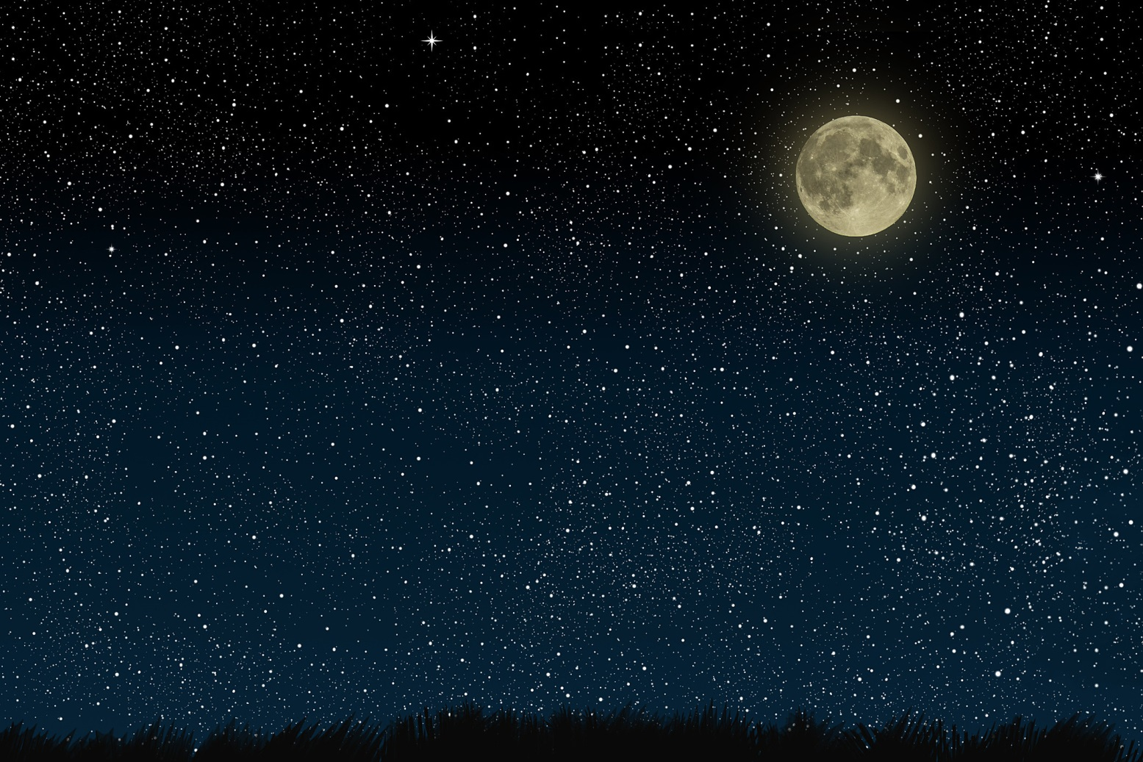
Nighttime drone operations
Visual Illusions
And
Physiological Conditions

Slide 2
Visual Deficiencies
Night Myopia (Nearsightedness)
Nearsightedness, or myopia, as it is medically termed, is a vision condition in which people can see close objects clearly, but objects farther away appear blurred.
Some people may experience blurred distance vision only at night. With "night myopia," low light makes it difficult for the eyes to focus properly. Or the increased pupil size during dark conditions allows more peripheral, unfocused light rays to enter the eye.

Slide 3
Visual Deficiencies
Hyperopia
Farsightedness, or hyperopia, as it is medically termed, is a vision condition in which distant objects can be seen clearly, but close ones do not come into proper focus. Farsightedness occurs if your eyeball is too short or the cornea has too little curvature. In these cases, your eye can't correctly focus the light that enters it.

Slide 4
Visual Deficiencies
Astigmatism
Astigmatism is a common vision condition that causes blurred vision. It occurs when the cornea (the clear front cover of the eye) is irregularly shaped or sometimes because of the curvature of the lens inside the eye.
If, for example, astigmatic individuals focus on power poles (vertical), the wires (horizontal) are out of focus

Slide 5
Visual Deficiencies
Presbyopia
Presbyopia is a vision condition in which the shape of the crystalline lens of your eye changes. These changes make it difficult to focus on close objects.
Normal part of the aging process

Slide 6
The Eye
Cones
Concentrated on the center of the retina
RESPONSIBLE FOR COLOR perception by sensing red, blue, and green light.
An area directly behind the lens, on the retina, is a small notched area called the FOVEA.
The fovea contains a high concentration of cone receptors
This is why we can see color well during the day, but not at night…BECAUSE OF THE CREATED BLIND SPOT

Slide 7
The Eye
Rods
Concentrated outside the fovea
Dim light and night receptors
ASSIST WITH PERIPHERAL VISION
Perceive moving images more easily than cones
In low light, cones lose much function; rods become more receptive in low light

Slide 8
Anatomy of the Eye

Slide 9
FAA Vision in Aviation Video

Slide 10
Self-Imposed Stress
Drugs
Exhaustion
Alcohol
Tobacco
Hypoxia
Hypoxia is a condition in which the body or a region of the body is deprived of adequate oxygen supply at the tissue level

Slide 11
Night Visual Illusions
Autokenesis
STATIC LIGHT APPEARS TO MOVE WHEN STARED AT
Caused by staring at a single point of light against a dark background for more than a few seconds
Prevented by focusing on objects at varying distances and avoid fixating on one source of light. Scan the sky.

Slide 12
Night Visual Illusions

Slide 13
Night Visual Illusions
False Horizon
Can occur when the natural horizon is obscured or not readily apparent.
CLOUD FORMATION CONFUSED WITH THE HORIZON

Slide 15
Night Visual Illusions
Reversible Perspective Illusion
AIRCRAFT MAY APPEAR TO BE MOVING AWAY WHEN IT IS REALLY MOVING TOWARD YOU
https://youtu.be/m6a2Qtu3728

Slide 16
Night Visual Illusions
Size – Distance Illusion
LIGHT INCREASING OR DECREASING IN LUMINESANCE IS INTERPRETED AS APPROACHING OR RETREATING

Slide 18
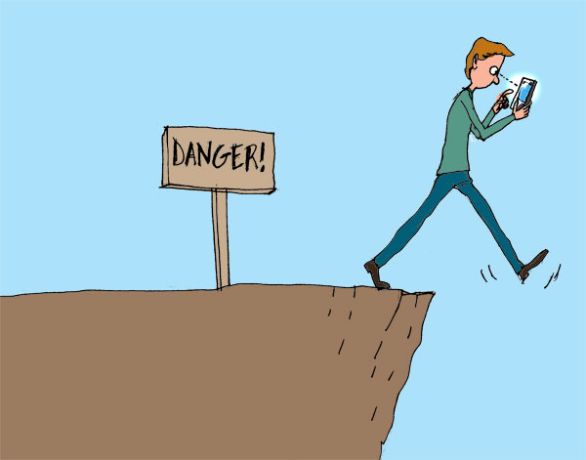
Night Visual Illusions
Fascination (Fixation)
TARGET HYPNOSIS
Occurs when pilots / observers ignore orientation cues and fix their attention on a goal or an object

Slide 19
Night Visual Illusions
Flicker Vertigo
FLASHING LIGHT ANNOYANCE
Can produce unpleasant/dangerous reactions such as: nausea, vomiting, and vertigo.
Prevented by proper scanning techniques
https://www.youtube.com/watch?v=ptQHY_5Agls

Slide 20
Night Visual Illusions
Relative Motion Illusion
PERCEPTION OF MOVING FORWARD BASED ON THE MOVEMENT OF ANOTHER OBJECT
Ex: When you’re stopped in your car with your foot on the brake and the car next to you is still moving
https://www.youtube.com/watch?v=XcdJjGk-M58

Slide 21
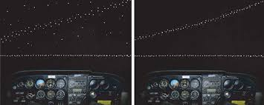
Night Visual Illusions
Confusion with Ground Lights
CONFUSE GROUND LIGHTS WITH STARS
Avoided by referencing flight instruments and establishing a true horizon

Slide 23
Night Visual Illusions
Height Perception Illusion
ABSENCE OF GROUND FEATURES FOR REFERENCE

Slide 24
Night Visual Illusions
Structural Illusions
HEAT WAVE, SNOW, SLEET, OR CURVATURE OF A WIND SCREEN

Slide 26
Night Visual Illusions
Altered Reference Planes
APPROACHING LINE OF MOUNTAINS, PILOT WANTS TO CLIMB

